Slide 1
100 YEAR LIFE – FEAR OR FAVOUR? Marjorie Ngwenya EXECUTIVE DIRECTOR, SCHOOL OF INSURANCE, AFRICA LEADERSHIP UNIVERSITY IMMEDIATE PAST PRESIDENT, INSTITUTE AND FACULTY OF ACTUARIES

Slide 2
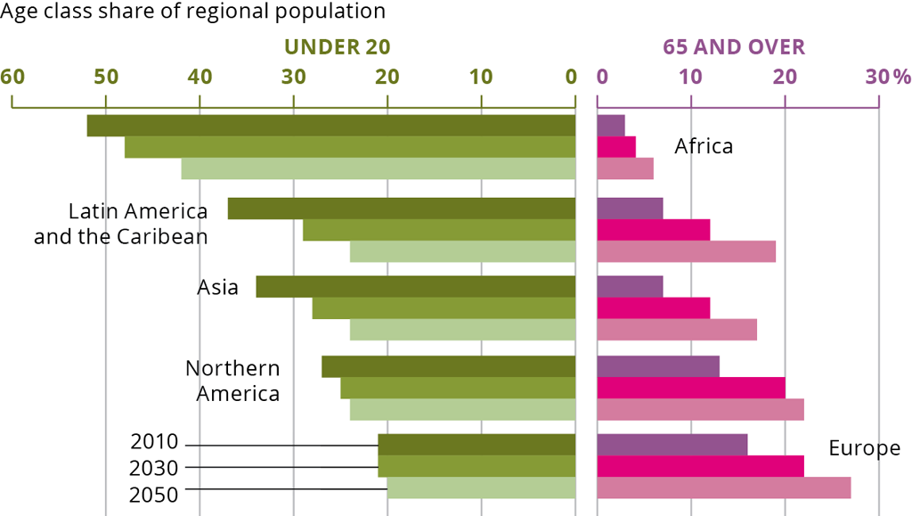
WHAT’S THE BIG ISSUE?
CREDIT: EUROPEAN ENVIRONMENTAL AGENCY

Slide 3
IT’S ABOUT… THE POLICY AGENDA
Shaping the Global Agenda on Ageing
-------
Meeting the Needs of Cognitive Decline
CREDIT: WEF

Slide 4
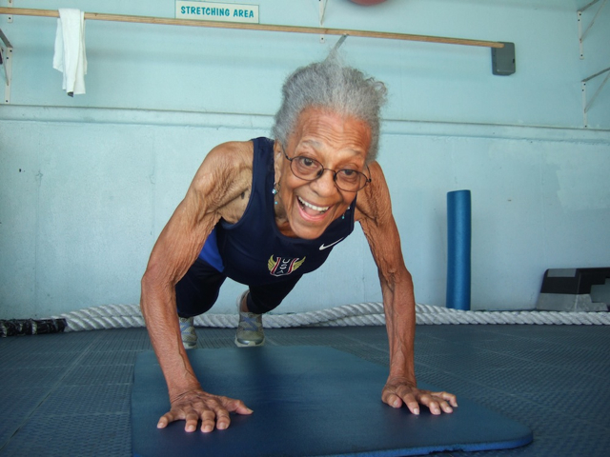
IT’S ABOUT… YOU
100-Year-Old Ida Keeling Makes History for Setting a World Record in 100-Meter Dash
CREDIT: BLACKAMAZING.COM

Slide 5
IT’S ABOUT… EVOLVING THE HEALTH SYSTEM
Investing in our future – medical and support systems for the elderly
CREDIT: CARP.CA

Slide 6
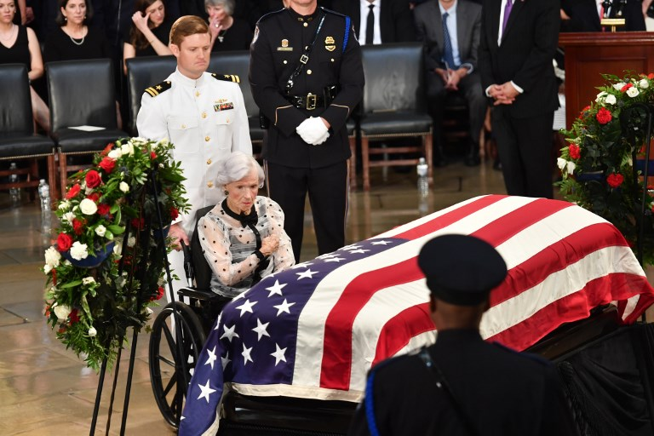
IT’S ABOUT… THE CHANGING FACE OF SOCIETY
106-year-old Roberta McCain attends her son John McCain’s funeral
CREDIT: NEWSLOCKER

Slide 7
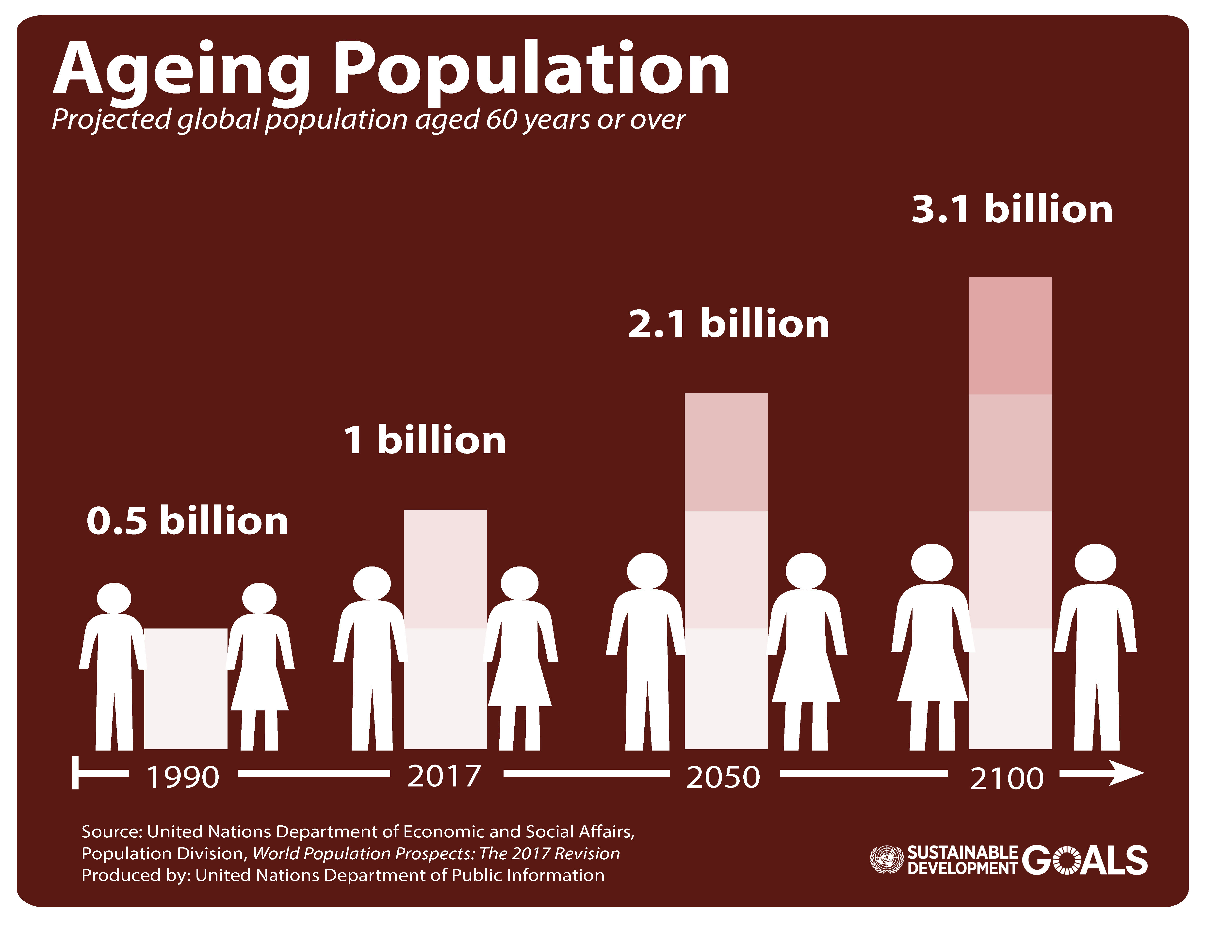
SO WHERE DOES THAT LEAVE US?

Slide 8
Thank you!

