Slide 1
Greece, the Speculators and the Regulators
Ian W. Marsh
Professor of Finance
Cass Business School

Slide 2
Choosing an exchange rate regime sensibly
Choosing an exchange rate regime badly
A good, old fashioned debt crisis
Inappropriate financial policy responses

Slide 3
Alternative regimes
Free Managed Target Fixed Currency Single
Float Float Zone Peg Board Currency
£/$ CHF/€ China? HK$ Euroarea
$/€ JPY/€ ERM Eng & Scot

Slide 4
Fixed versus Floating
Fixed regimes
Provide a nominal anchor for monetary policy
Facilitate trade and investment
Avoid speculative bubbles/mispricing
Floating regimes
Allow policy independence
Are an extra adjustment tool
Avoid speculative attacks

Slide 5
Optimal Currency Area
An OCA can be defined as
“a region that is neither so small that it would be better off fixing to (or adopting) the currency of a neighbour, nor so large that it would be better off splitting into sub-regions with different currencies.”

Slide 6
Optimal Currency Area
A country should consider fixing if:
It trades internationally a lot
It will not suffer by losing monetary independence
Key requirements:
There is a single country it mainly trades with
The two countries face similar shocks
Other adjustment mechanisms exist (labour mobility or fiscal transfers)

Slide 7
Optimal Currency Area
In 1990s and early 2000s, it was not obvious that Greece or other peripheral European countries were inside the optimal currency area centred on France and Germany
The decision to let Greece in was influenced by the research of two leading academics…

Slide 8
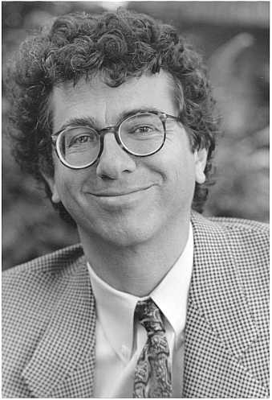
New OCA Approach

Slide 9
New OCA Approach
Change the exchange rate regime and you change the economy’s behaviour:
You will trade more with a partner country if you fix your exchange rate against it
Crucially, while fixing the exchange rate increases trade, entering a currency union triples trade
If you trade more with a country, your business cycle will converge with their business cycle
Even if you are not an OCA ex ante you can become one ex post

Slide 10
New OCA Approach
So if Greece wasn’t quite ready to join the Euro club, by joining it Greece would soon be much more suitable
The only problem was, Greece didn’t become more suitable
And it had one weakness where pressure could be built…

Slide 11
Classical Debt Crisis
Fixed exchange rates are prone to speculative attack
Currency unions mean no exchange rate, so no place for speculators to attack…
…unless the weak country is dependent on another financial market
The debt market let the speculators attack

Slide 12
Policy Responses
Ban short sellers
Kill the Credit Default Swap market
Introduce a Tobin Tax

Slide 13
Jackals, Hyenas and Vampire Squids
Only academics seem to like short sellers:
They make markets liquid
They stop bubbles from happening
They are smarter than most other traders
The knee jerk reaction to ban short sellers during 2007/08 banking crisis made markets worse

Slide 14
Kill the Messenger

Slide 15
Tobin Taxes
Bad idea if you want to make markets more efficient
But they are a good and politically popular way of taxing financial institutions
Who will then pass these costs back onto us

